Slide 1

CCAC: Crossroads Classic Analytics Challenge 24
Team Name: H&G
Team Members: Xiaoyu Guan, Weigang Hou
Division: Graduate

Slide 2
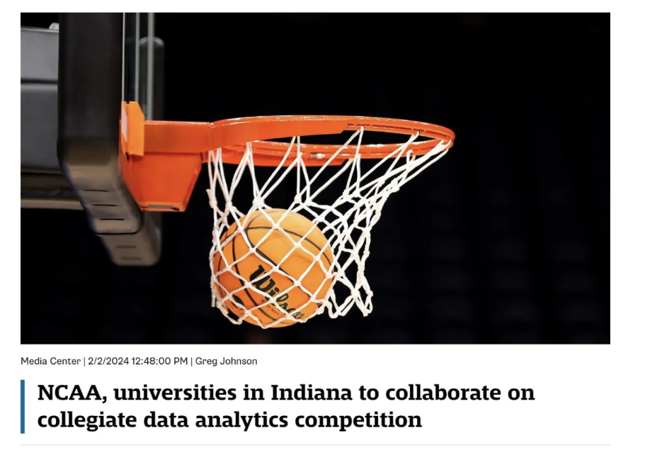
Problem Description
Predict NCAA Championship Ticket Sales
The NCAA orchestrates a dynamic landscape of sporting events, boasting 90 championships annually across three divisions and spanning over twenty sports.
Central to its mission is the strategic marketing and sale of tickets, a process fueled by insights gleaned from past and potential customers.
Project problem: how we can harness the wealth of data, coupled with external sources, to predict ticket purchases？
Source: https://crossroadsclassicanalyticschallenge.com/

Slide 3
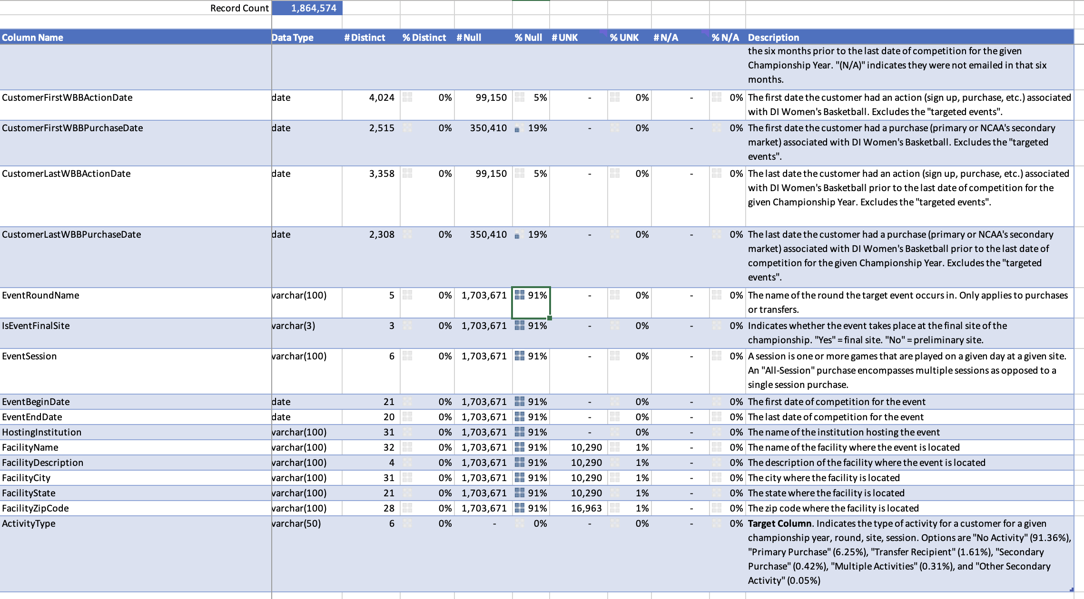
Data Preprocessing
Prepare the data for prediction model
What we have:
a training set, test set, a submission template and data dictionary
Prediction target: “ActivityType” column
What the data files look like:
Large data size (200k+)
Lots of missing values
Mixed variable types: numerical, categorial, etc.
Difference between “UNK”, “NO” and “N/A”

Slide 4
Data Preprocessing (cont’d)
How we preprocess the data file
Relationship investigation between purchase type and customer characteristics
By sorting customers in different states, we can find some state has preferred purchase type (e.g., MA- primary purchase; SC-mixed purchase types, etc.), therefore, “FacilityState” and “FacilityZipCode” could be important variables.
The two date variables: “EventBeginDate” and “EventBeginDate” are highly related to activity type is exist or no activity.
“EventRoundName”, “IsEventFinalSite”, “EventSession” are always has value if activity type exist and thus potentially functions as input variables.
The “duration_WBBA” and “duration_WBBP” are created based on give data and used for determining the activity level of customers.
Other columns with less Null are considered as input variables to avoid any possible missing of characteristics.
Different purchase type are encoded as different integers for transformation convenience.
The final selected input variables (total 12 vars):
Numerical vars = ['duration_WBBA', 'duration_WBBP', 'event_date_indicator’] 3
Categorical vars = ['IsCustomerInNCAAMembership', 'CustomerID’, 'HasCustomerClickedOrOpenedEmailsSixMonthsPrior', 'EventRoundName’, 'IsEventFinalSite', 'EventSession', 'HostingInstitution', 'FacilityState', 'FacilityZipCode’] 9

Slide 5
Prediction Model
The model we tried:
Different prediction model are tried including Logistic Regression, Decision Tree, Neural Network and Gradient boosting, the accuracy scores (training set) are:
Logistic Regression: 0.91
Decision Tree: 0.93
Neural Network: 0.03
Gradient boosting: 0.98
We decided to use Gradient boosting for test set, the final score we got is: 0.97963

Slide 6
Thank You

